Slide 1

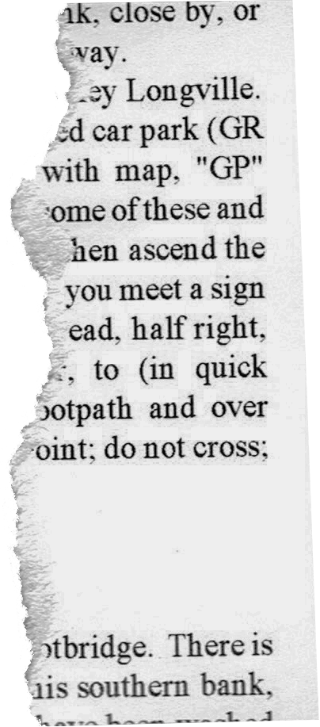



E-Commerce
By : Marlen Zharkynbai uly

Slide 2

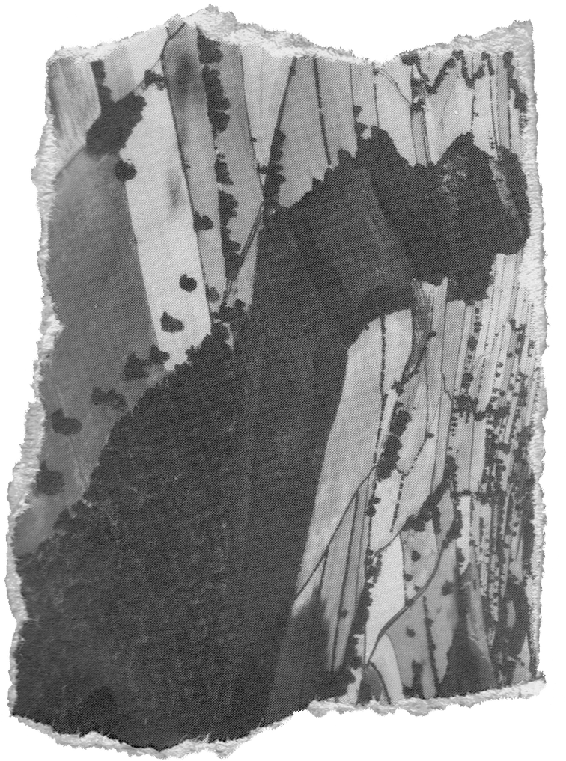





The project aims to develop a robust, scalable, and user-friendly E-Commerce platform that allows users to browse, search, purchase, and manage products online. The platform will also empower administrators to manage products, orders, and user data efficiently.
Project
Overview

Slide 3



For Customers:
Easy and intuitive shopping experience
Secure payment options and real-time order tracking
For Admins:
Efficient product and order management
Streamlined business operations
For Business:
Increase customer reach and sales
Gain insights through analytics and reporting
Project Goals

Slide 4


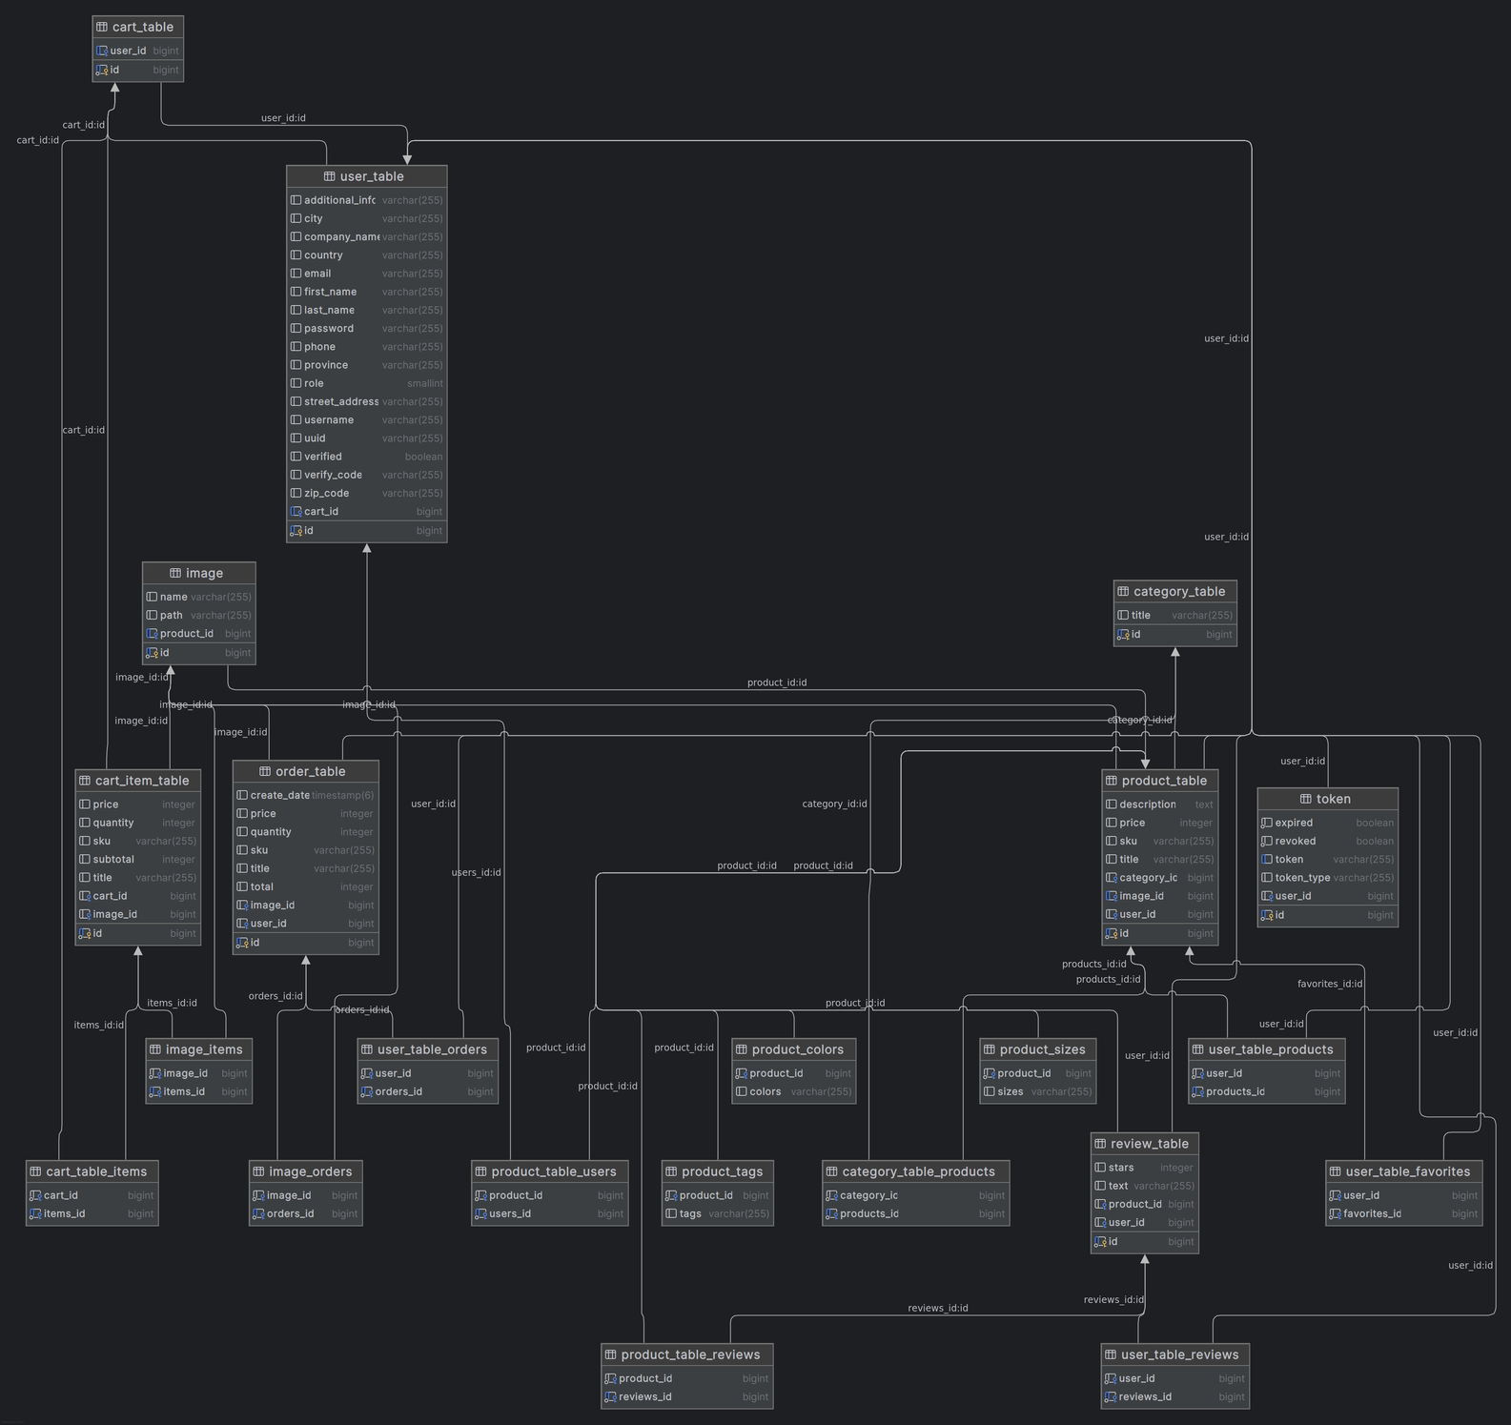
E-R Model
Relationships:
ADMIN-PRODUCT: One-to-Many (A ADMIN can CREATE MANY PRODUCTS).
USER-ORDER: ONE-TO-MANY (USER CAN HAVE A MANY ORDERS)
PRODUCT-IMAGE: ONE-to-One (ONE PRODUCT can has only one omage).
PRODUCT-REVIEW: ONE-TO-many (PRODUCT HAS many reviews).

Slide 5


Tech
stack
JAVA 22
postman
Postgresql
git/github
spring boot
maven

Slide 6
Thank You

